Slide 1
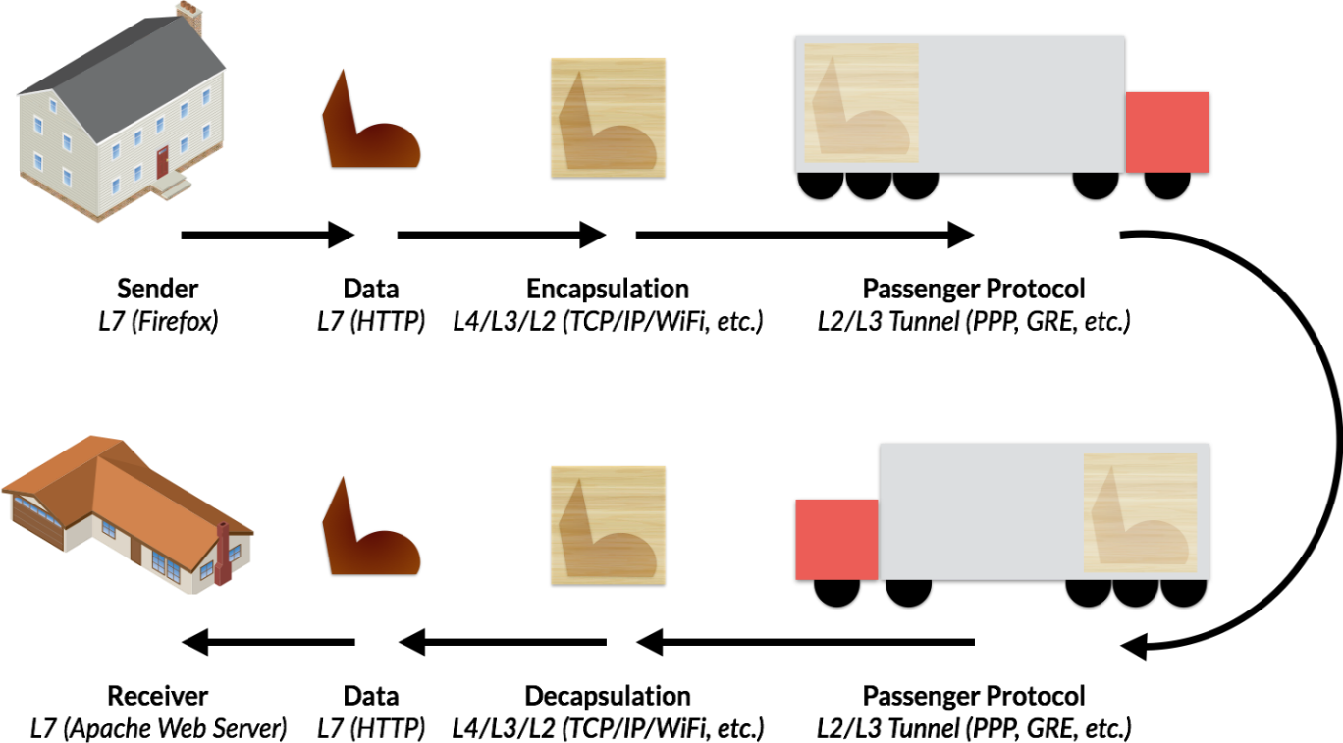
VPN Concept:
VPN is a Network term, which is stands for Virtual Private Network.
VPN allows creating secure connection to another network over the Internet.
VPNs create the tunnels that allow users and systems to connect securely.
Virtual Private Network (VPN) is a secure private tunnel over an insecure path.
There are different technologies available for Wide Area Network (WAN) connectivity.
Main drawback of many Wide Area Network (WAN) connectivity solutions is "Cost".
VPN is a Network Security Technology, to secure private network traffic over a public.
VPN ensures Privacy for network data from the source device to destination device.
VPN ensures Data Integrity for network data from the source device to destination device.
VPN using network security protocols like IPSec to provide Privacy and Data Integrity.
IPSec VPN provide Data Confidentiality by encrypting the data at the sending device.
IPSec VPN provide Data Confidentiality by decrypting the data at receiving end.
IPSec VPN also provides Data Integrity by using Hashing Algorithms like MD5 and SHA.
Cisco supports several types of VPN implementations on the ASA IPSec & SSL based.
Virtual Private Network (VPN) technology relies on the concept of tunneling.
VPN tunneling involves establishing and maintaining a logical network association.
Public network is a network to which anyone can connect, and anyone can use.
Private network is any network to which access is restricted and not for public use.

Slide 2


In analogy, each person traveling by submarine is like a remote user accessing the company's private network.
Imagine that you live on an island in a huge ocean. There are thousands of other islands all around you, some very close and others farther away. The common means of travel between islands is via ferry. Traveling on the ferry means that you have almost no privacy: Other people can see everything you do.

Slide 3
VPN Classification:
Classification Based on Deployment:
Site to Site VPN
Remote-Access VPN
Classification Based on OSI Layers:
Layer 4/7 VPN - WebVPN
Layer 3 VPN - IPSec, GRE, DMVPN, SSL VPN, L2TPV3
Layer 2 VPN - L2TP, PPTP, MPPE, Frame Relay, X.25, ATM
Classification Based on Trust Level:
Intranet VPN
Extranet VPN
Remote VPN
Classifications Based on Customer Point of View:
Traditional VPN:
Frame-Relay (L2 VPN)
ATM VPN (L2 VPN)
CPE Based VPN:
L2TP and PPTP (Layer 2 VPN)
IPSec VPN (Layer 3 VPN)
Provider Provisioned VPN:
BGP/MPLS (L2/L3 VPN)
Session Based VPN:
SSLVPN/WebVPN (L4/L7 VPN)
Classification Based on Security Level:
Secure VPN
Trusted VPN
Hybrid VPN
Classification based on Cleartext VPNs:
MPLS,VPLS
L2VPN, L3VPN
PPTP, L2F,L2TP

Slide 4
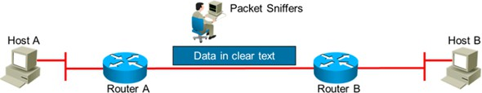
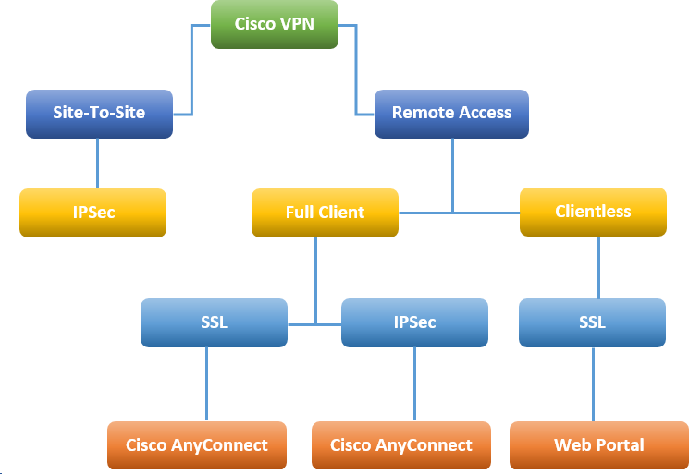
Advantages of VPNs:
Cost Savings | Organizations can use VPNs to reduce connectivity costs.
Scalability | Organizations can use the Internet to easily interconnect new offices.
Security | Advanced encryption and authentication protocols protect data.
Compatibility | VPNs can be implemented across a wide variety of WAN link options.
Better Performance | VPNs provide better performance.
Flexible & Reliable | VPNs is flexible and reliable.
Why Use Secure VPN:
Eavesdropping Attacks | Traffic can be sniffed from unsecured lines.
Network Spoofing Attacks | Attacker can sniff the encrypted data over the public network and use it to make itself as a legitimate VPN peer.
Man-in-The-Middle-Attacks | Attacker gets in-line with normal flow of traffic just to sniff the critical information.
Type of VPNs:
There are two main types or categories of VPNs, Site-to-Site VPNs and Remote-Access VPNs.

Slide 5
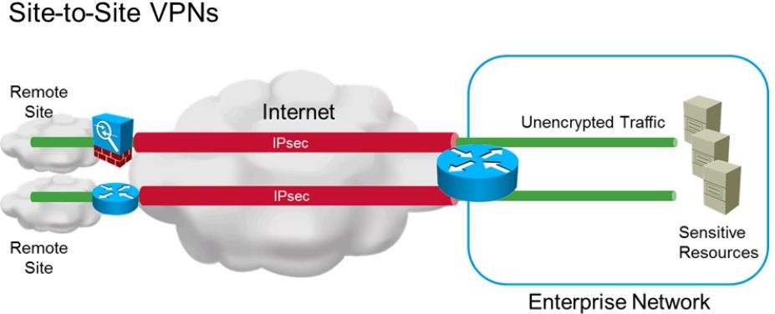
Site-to-Site VPNs:
A VPN connection that allows connecting two LANs is called a Site-to-Site VPN.
Connect two private LAN over Public Network, Private to Private over Public Network.
It is also called Site-to-Site VPN, LAN-to-LAN VPN or Hub-and-Spoke VPN.
Many organizations use IPsec, GRE, and MPLS VPN as Site-to-Site VPN protocols.
Site-to-Site VPNs can connect branch office network to company Head-Office Network.
VPN allows secure connection of corporate office with branch offices or remote offices.
Site-to-Site, VPN are built over Internet between two or more office locations.
Site-to-Site Virtual Private Network (VPN) connect entire networks to each other.
The VPNs may be placed in the enterprise internet edge, enterprise WAN edge or branch.
Remote-Access VPNs:
Enable users to work from remote locations such as their homes & other premises.
Remote-Access VPNs connect client devices to LAN over the Internet infrastructure.
Individual hosts or clients, access a company network securely over the Internet.
Each host typically has VPN client software loaded or uses a web-based client.
Whenever the host send any information, the VPN client software encapsulates it.
Whenever the host send any information, the VPN client software also encrypts it.
It allows individual users to establish secure connections with a remote network.
Remote-Access VPN tunnels are formed between a VPN device & an end-user PC.
The remote user requires the Cisco Virtual Private Network (VPN) client software.
Remote access Virtual Private Network connect individual users to private networks.
Remote-access Virtual Private Network connects individual host to company Network.

Slide 6
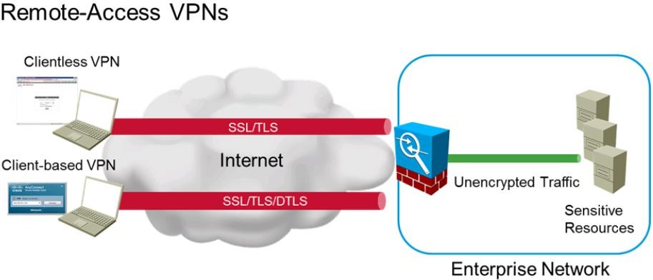
Protocols for VPN:
The following are different protocols use for VPN implementation:
Point-to-Point Tunneling Protocol | PPTP
Layer 2 Forwarding Protocol | L2FP
Layer 2 Tunneling Protocol | L2TP
Generic Routing Encapsulation Protocol | GRE
Multiprotocol Label Switching | MPLS
Internet Protocol Security | IPSec
Secure Sockets Layer | SSL
Encryption Algorithms for VPN:
The following are the typical encryption (Confidentiality) algorithms:
Data Encryption Standard (DES) | 064 bits long
Triple Data Encryption Standard (3DES) | 168 bits long
Advanced Encryption Standard (AES) | 128 bits long
Advanced Encryption Standard (AES) | 192 bits long
Advanced Encryption Standard (AES) | 256 bits long
Hashing Algorithms for VPN:
The following are the Hashing (Integrity) algorithms:
Secure Hash Algorithm | SHA
Message Digest Algorithm 5 | MD5
Authentication Algorithms for VPN:
The following are common authentication methods:
Pre-Shared Keys | Digital Certificates

